Slide 1
QUIQ POS - UX Design Document
Enter comments in the pages and revert.

Slide 2
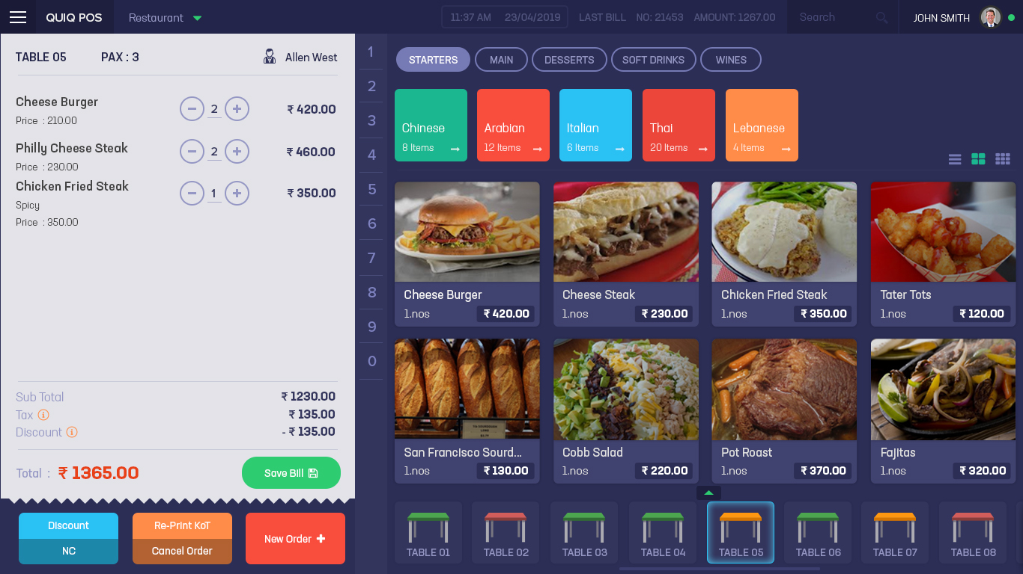
Home Page
Comments

Slide 3
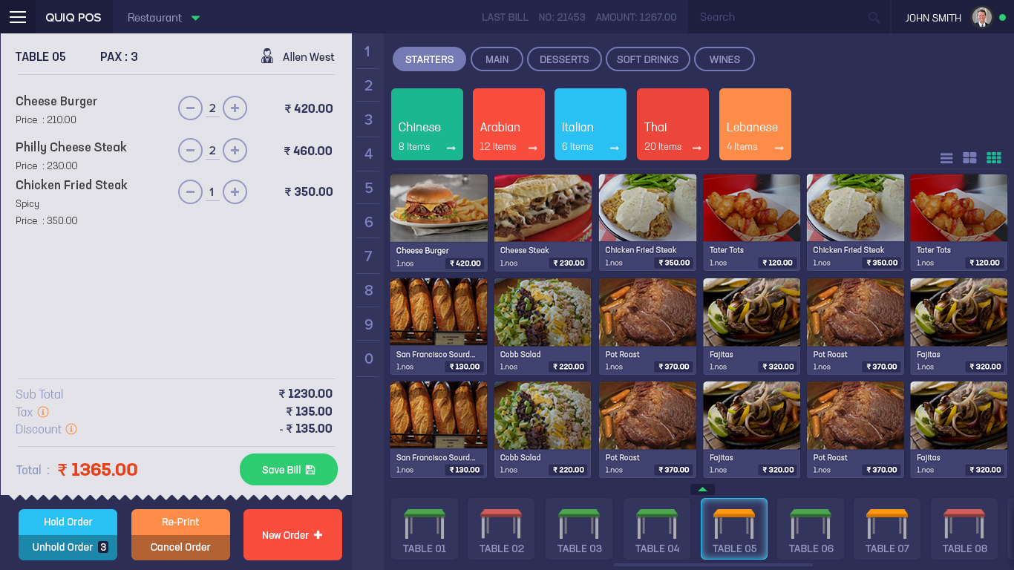
Home Page - Small Thumbnail View
Comments

Slide 4
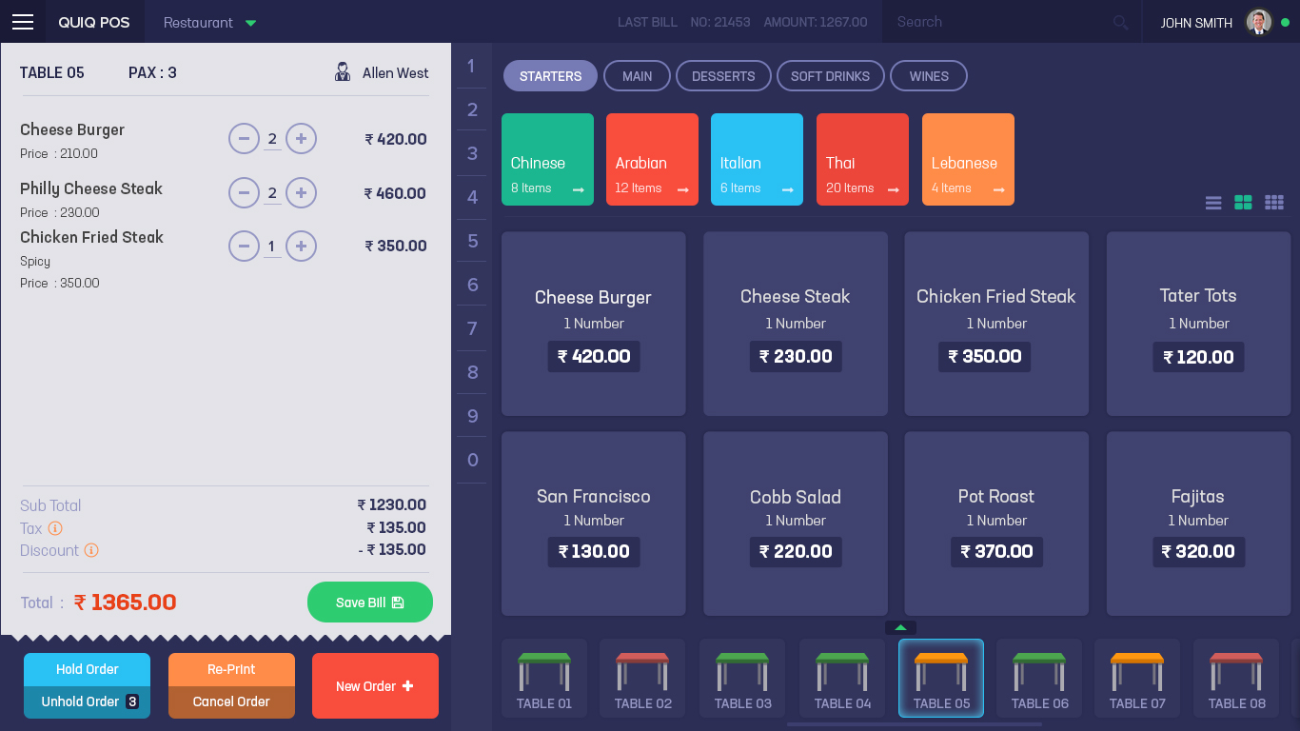
Home Page - No Image
Comments

Slide 5
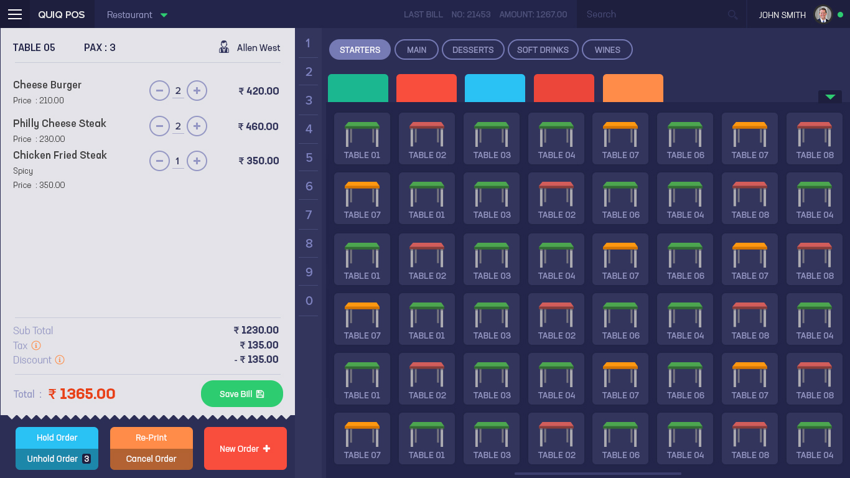
Home Page - Table List Expanded
Comments

Slide 6
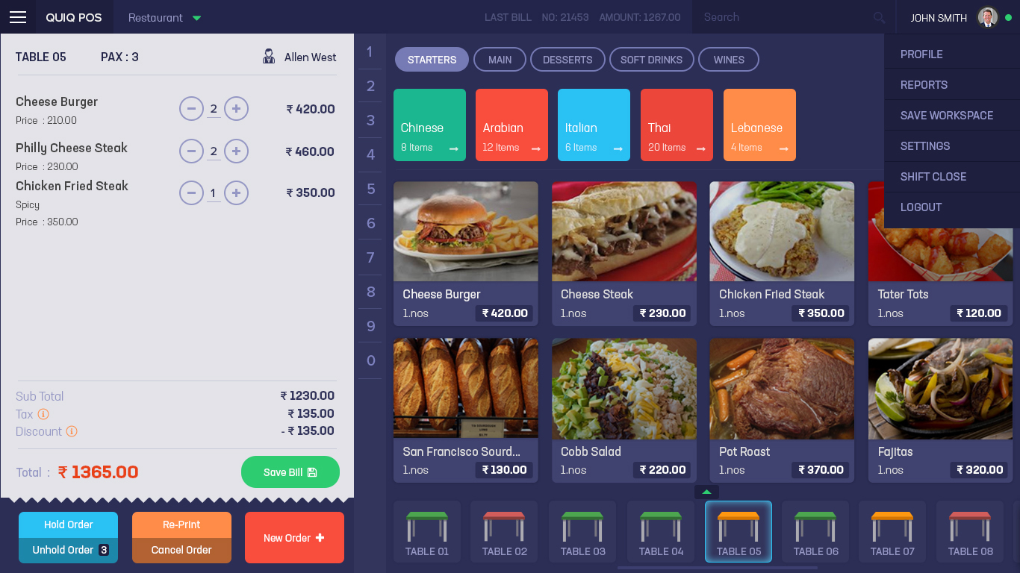
Home Page - User Settings Menu
Comments

Slide 7
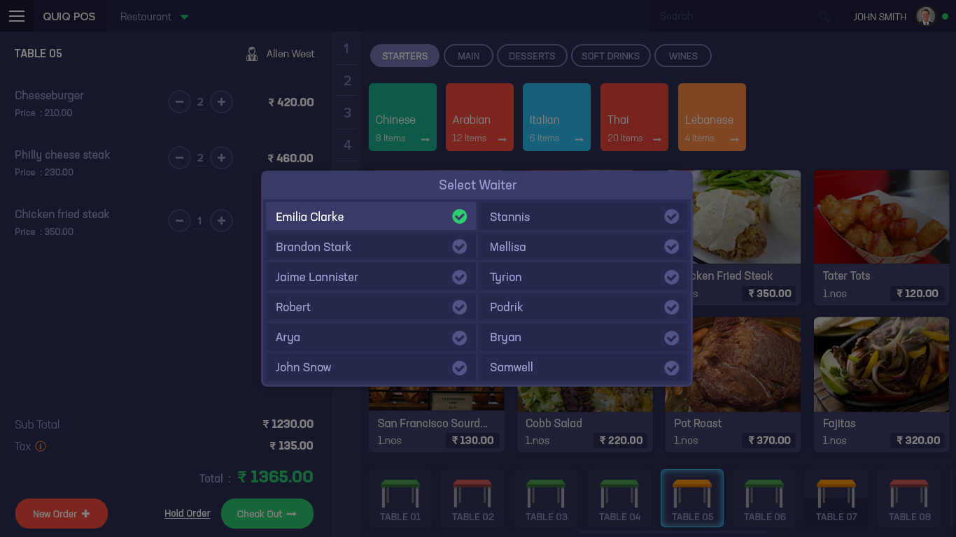
Home Page - Waiter Selection
Comments

Slide 8
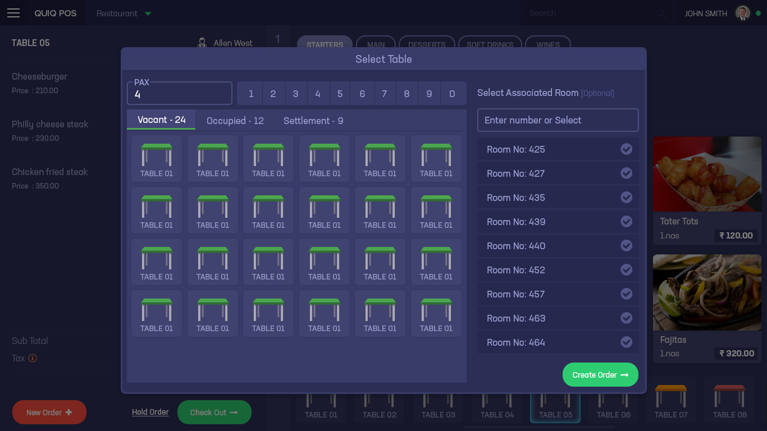
Home Page - Table Selection
Comments

Slide 9
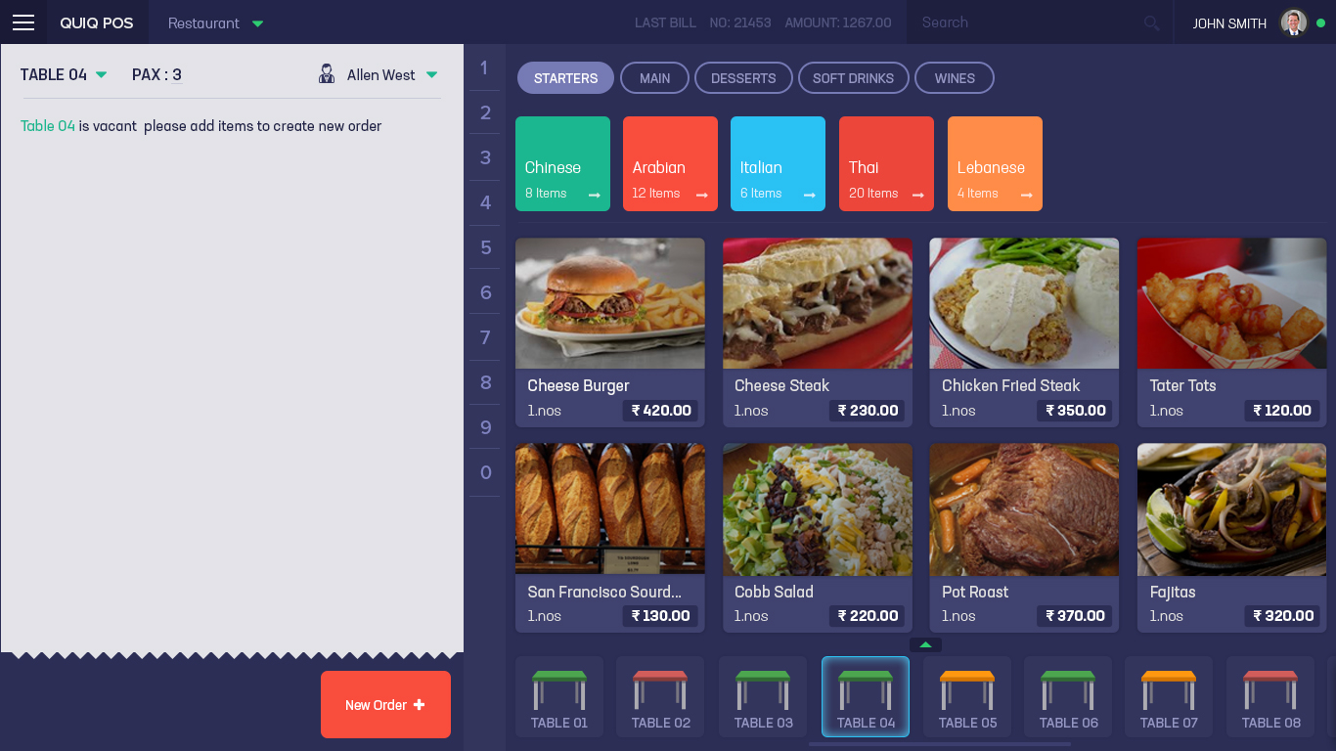
Home Page - New Order from Vacant Table
Comments

Slide 10

Home Page Additional Item button in Bill Preview
Comments

Slide 11
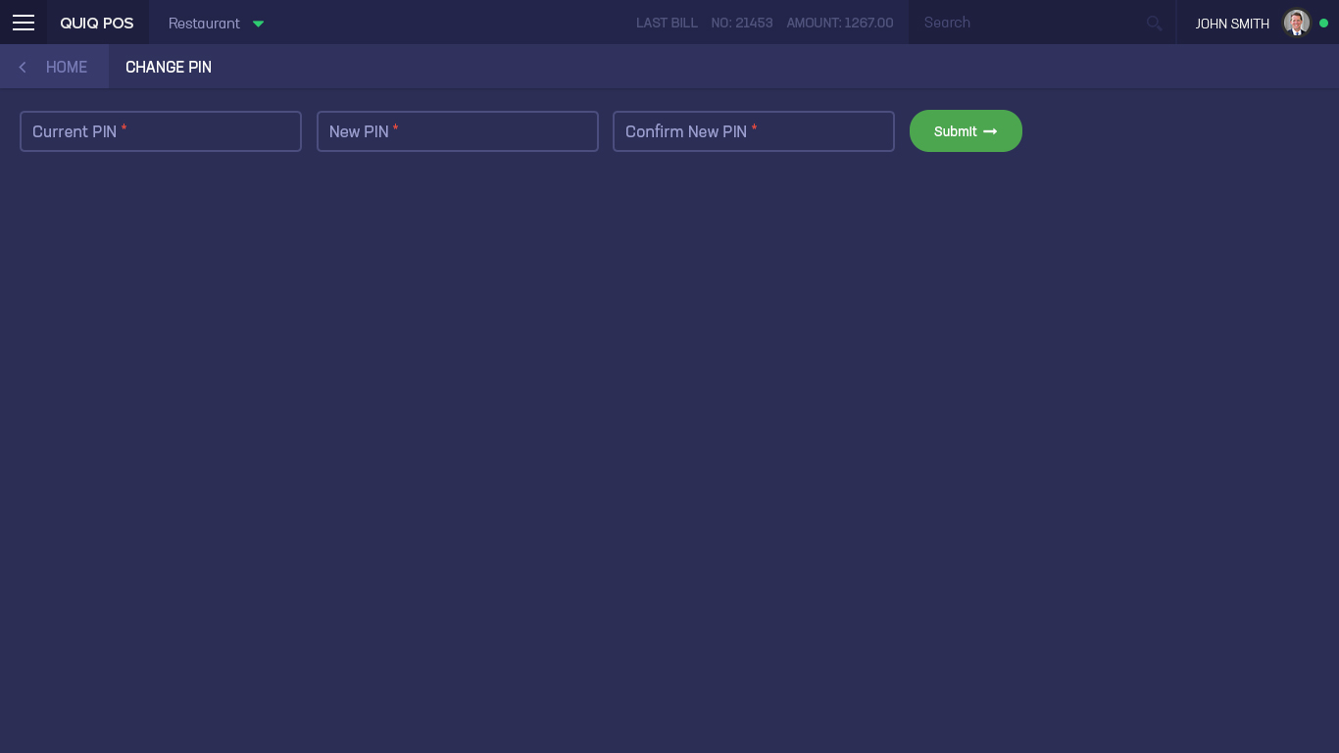
Change Pin
Comments

Slide 12
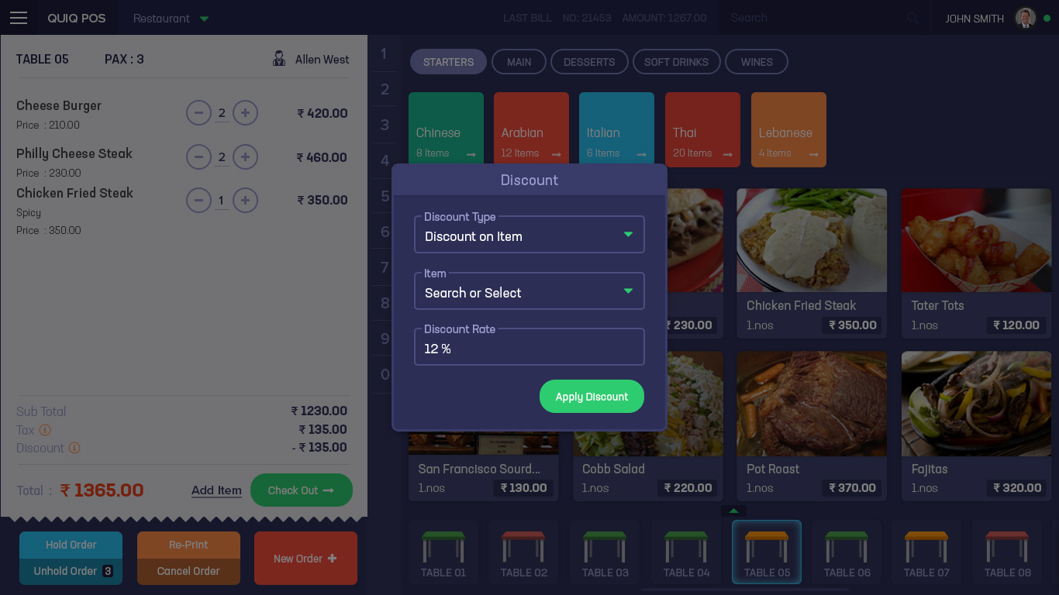
Add Discount
Comments

Slide 13
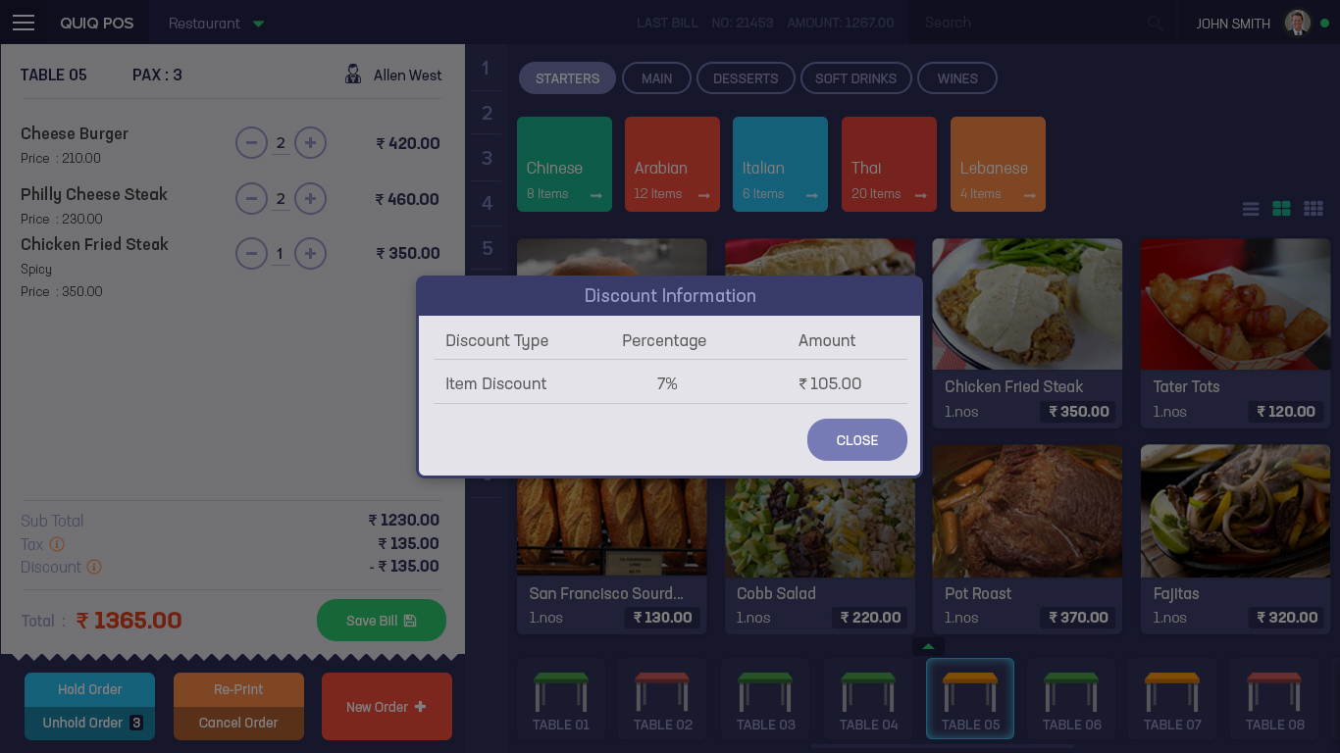
Discount Info
Comments

Slide 14
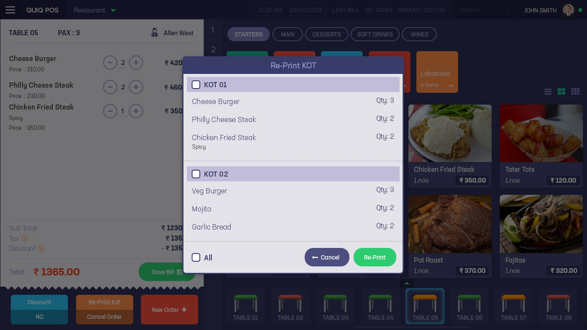
Home Page - Re-Print Kot
Comments

Slide 15
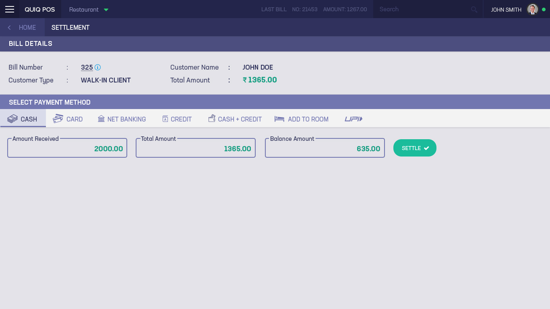
Settlement - Cash
Comments

Slide 16
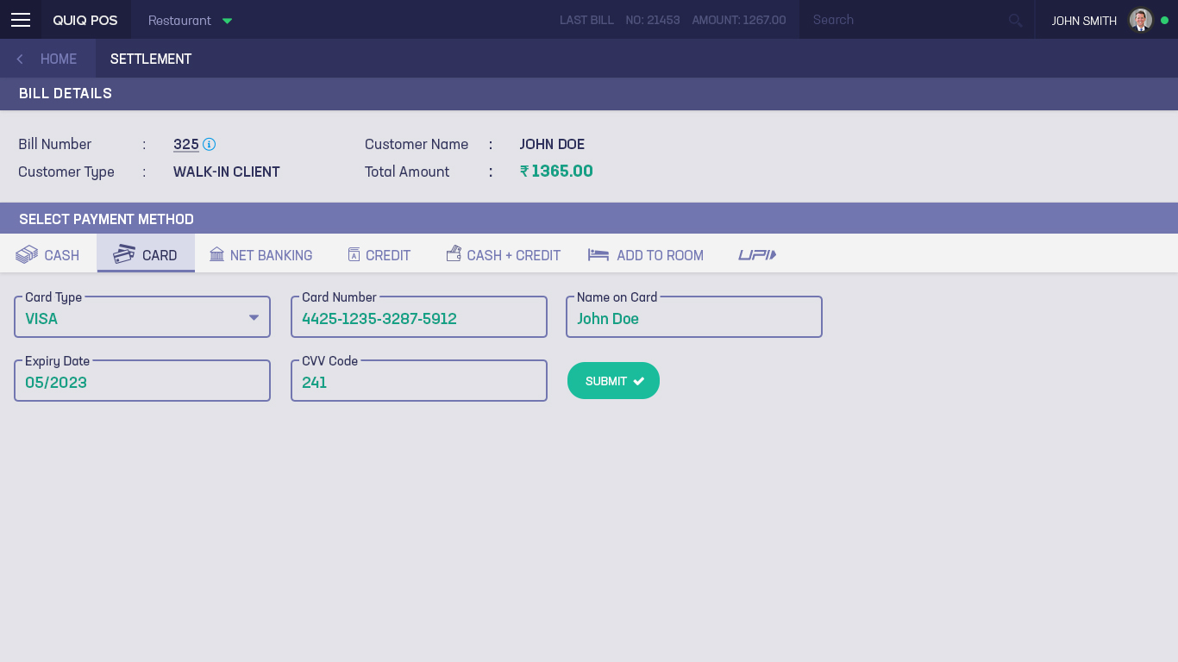
Settlement - Card
Comments

Slide 17
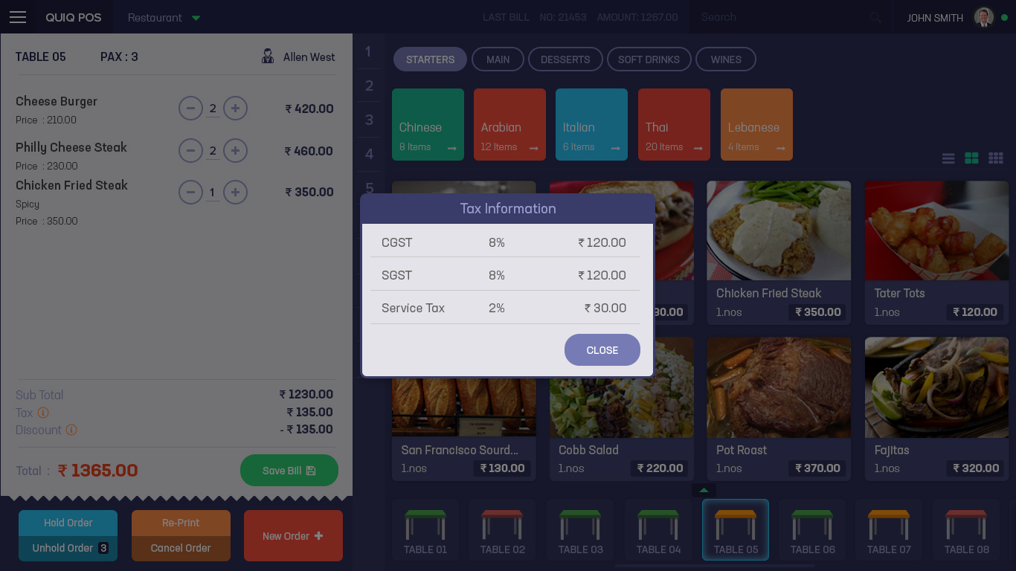
Tax Info
Comments

Slide 18
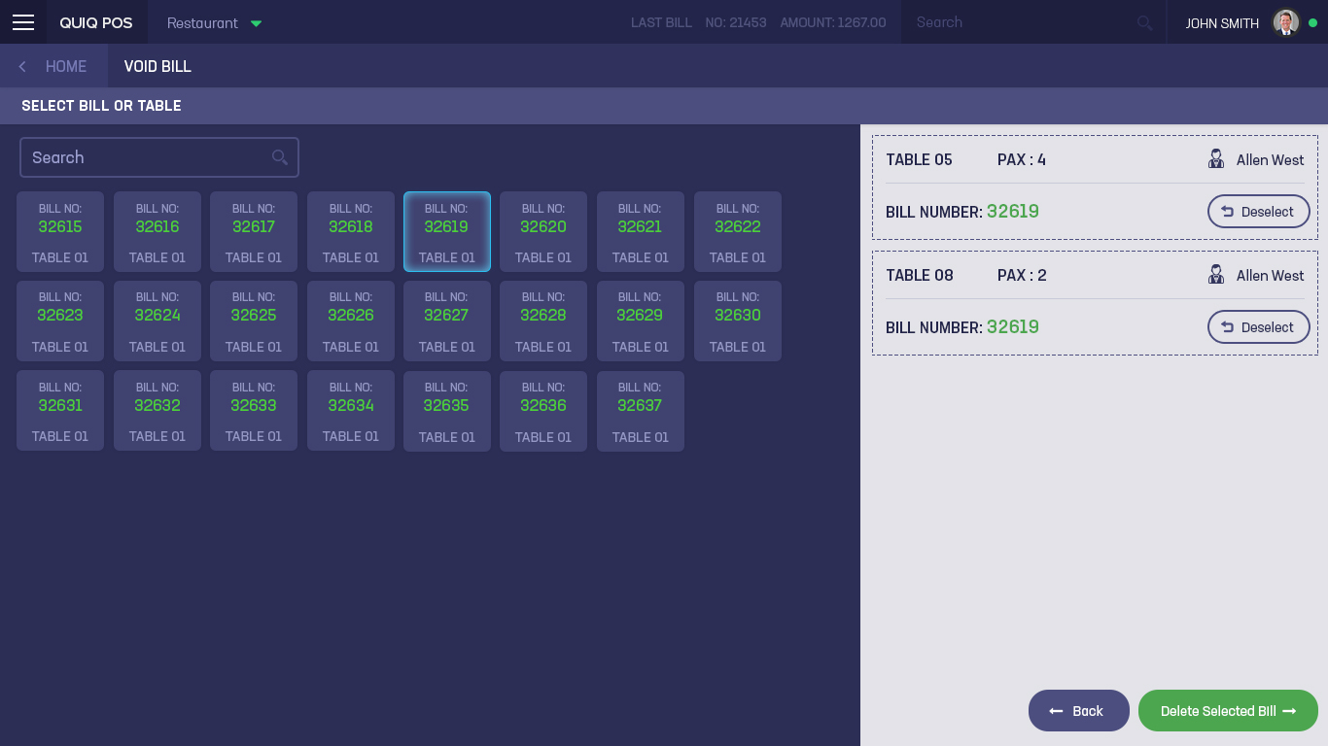
Void Bill
Comments

Slide 19
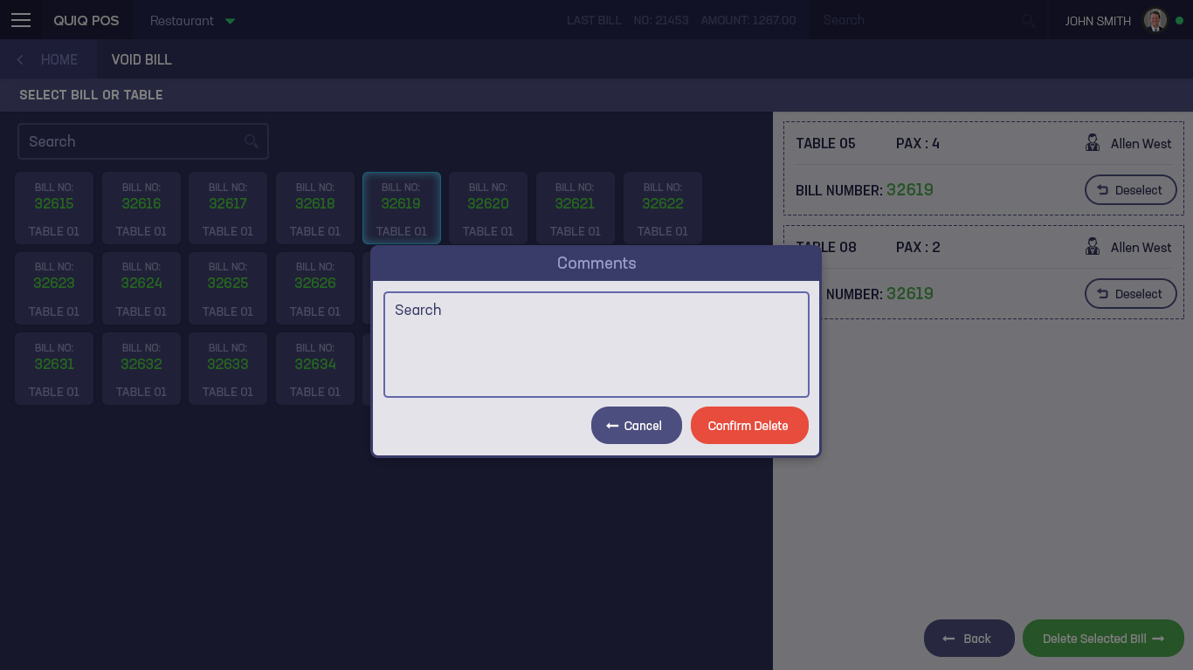
Void Bill Comments and Confirmation
Comments

Slide 20
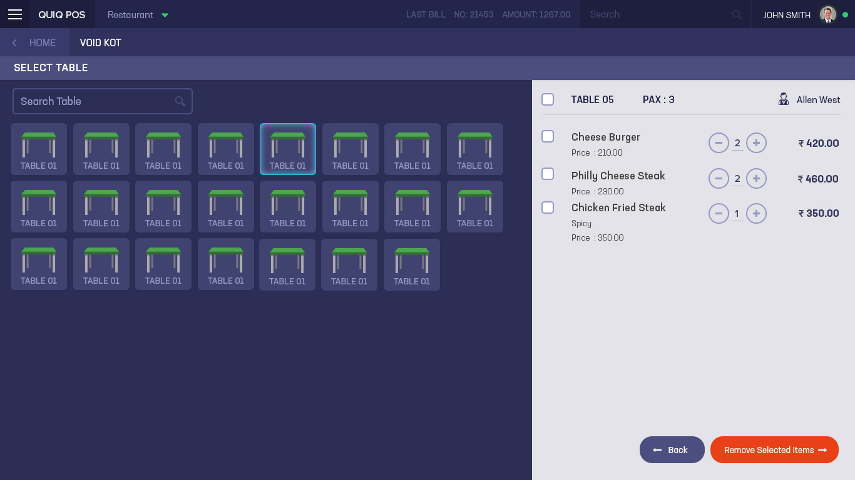
Void KOT
Comments

Slide 21
VOID Bill
Comments

Slide 22

VOID Bill - Confirmation
Comments

